Slide 1






FUNCORE
Gaming Analytics Dashboard
(SQL + Power BI)

Slide 2



@funcore
Problem Statement
Online gaming platforms generate a large amount of user interaction and gameplay data, but this data often remains unstructured and underutilized.
There was no system to analyze which games are most engaging or how much time users spend playing each game.
It was difficult to identify high-performing users or games based on score patterns or session frequency.
Tracking how user preferences vary by age or game category was not possible without structured analysis.
There was no central dashboard or visual tool to summarize overall gameplay behavior, trends, or top performers.

Slide 3


@funcore
Objective
Online gaming platforms generate a large amount of user interaction and gameplay data, but this data often remains unstructured and underutilized.
There was no system to analyze which games are most engaging or how much time users spend playing each game.
It was difficult to identify high-performing users or games based on score patterns or session frequency.
Tracking how user preferences vary by age or game category was not possible without structured analysis.
There was no central dashboard or visual tool to summarize overall gameplay behavior, trends, or top performers.

Slide 4

@funcore
Project overview
I wrote and executed over 25 complex SQL queries to extract gameplay patterns, performance metrics, and session-based trends.
Cleaned, joined, and transformed data across multiple relational tables for meaningful analysis.
Built a fully interactive and insightful Power BI dashboard with slicers, tooltips, page navigation, and category-based filtering.
Applied advanced DAX measures to calculate KPIs like total play time, top users, game popularity, and score rankings.
Delivered a visually rich report that reveals user behavior, top games, and deep gameplay insights in a structured and interactive format.

Slide 5

@funcore
Data Collection & Preparation
Synthetic data generated with realistic behaviors from 1000+ users.
Game categories included: Classic, Puzzle, Word, Arcade, Endless, Multiplayer.
Structured into 4 key tables: Users, Games, GameSession, UserLeaderBoard.
Metrics included: scores, session durations, most played game, total time, etc.

Slide 6



@funcore
Tools & Technologies Used
MySQL Workbench
Power BI
Microsoft Power BI
mysql
Power Query
Microsoft Excel

Slide 7
@funcore
Advance topics applied
Common Table Expressions (CTEs)
Multi-table Joins
Window Functions
Data Segmentation and Filtering
Subqueries
DAX Functions
Date and Time Functions
ToolTip Feature

Slide 8
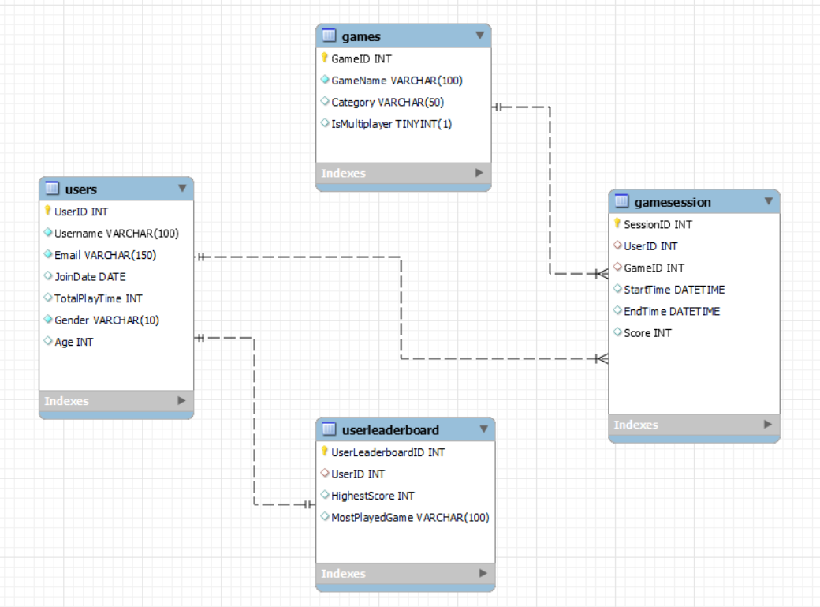
@funcore
Database setup

Slide 9
@funcore
SQL Query Highlights
Top 3 games with longest average session duration.
Power users (played >04 sessions and in top 10% highest score).
Highest average scorer for each game.
Users who improved their scores over time (using LAG).
Retention: users played 2nd session within 2 days of first session
Note : Not all queries are included in this presentation.
Please visit the GitHub repository to view the complete set of 25+ SQL queries with logic and results.

Slide 10
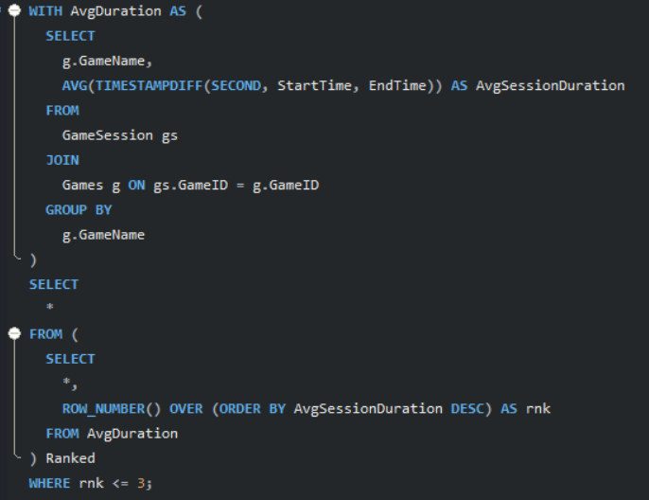
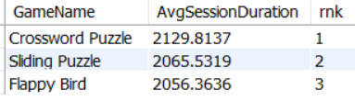
@funcore
Top 3 games with longest average session duration
OUTPUT

Slide 11
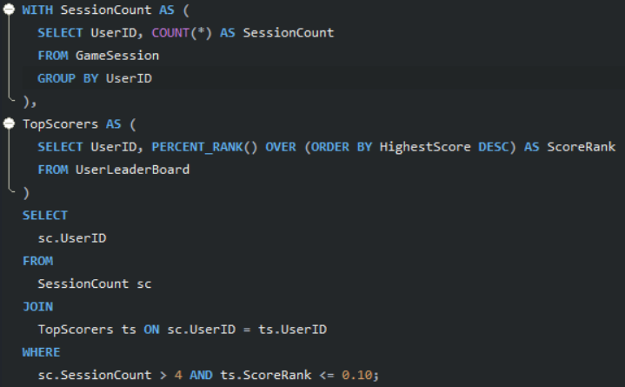
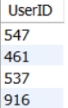
@funcore
Power users (played >04 sessions and in top 10% highest score)
OUTPUT

Slide 12
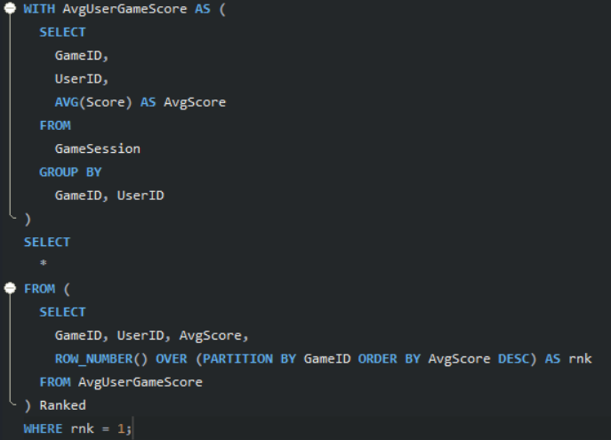
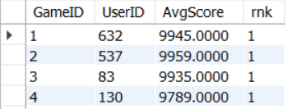
@funcore
Highest average scorer for each game
OUTPUT

Slide 13
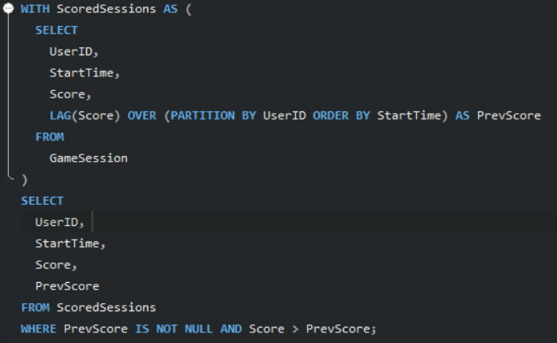
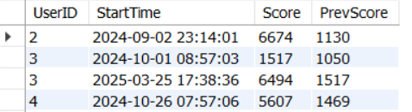
@funcore
Users who improved their scores over time (using LAG)
OUTPUT

Slide 14
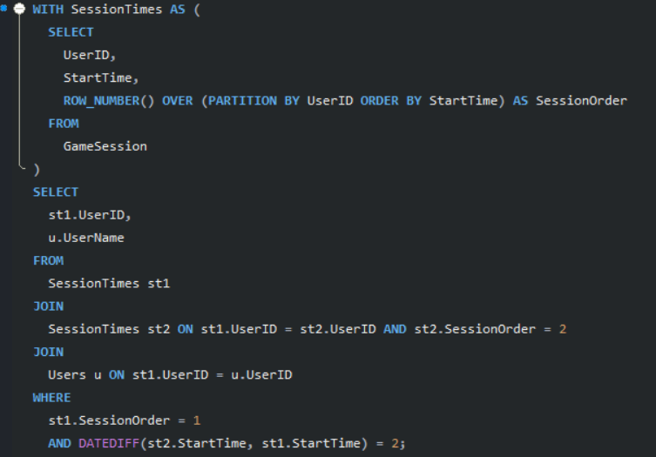
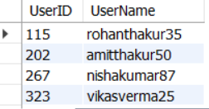
@funcore
Retention: users played 2nd session within 2 days of first session
OUTPUT

Slide 15
@funcore
Power BI Report
Home Page: Central hub with navigation to all report sections
User Performance: Top Users, Avg. sessions per user, Session count vs avg. score
Gameplay Performance: Sessions by game, avg. score, top games, monthly trends
Features: Slicers, tooltips, KPIs, clean layout, custom visuals for deep insights

Slide 16

@funcore
HOME Page

Slide 17
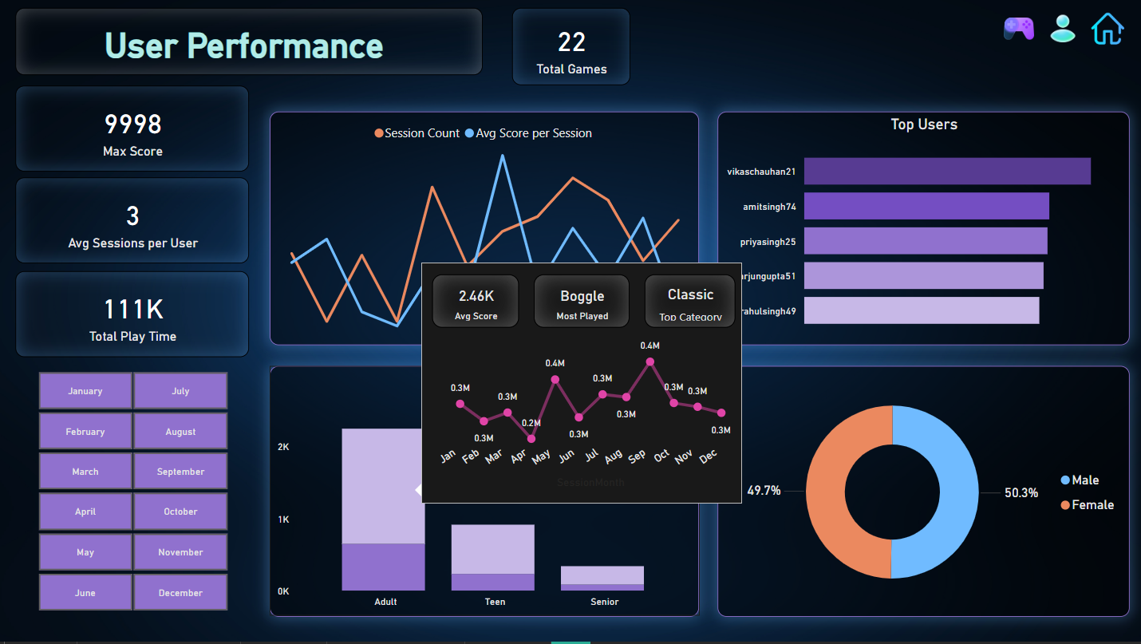
@funcore
User performance

Slide 18
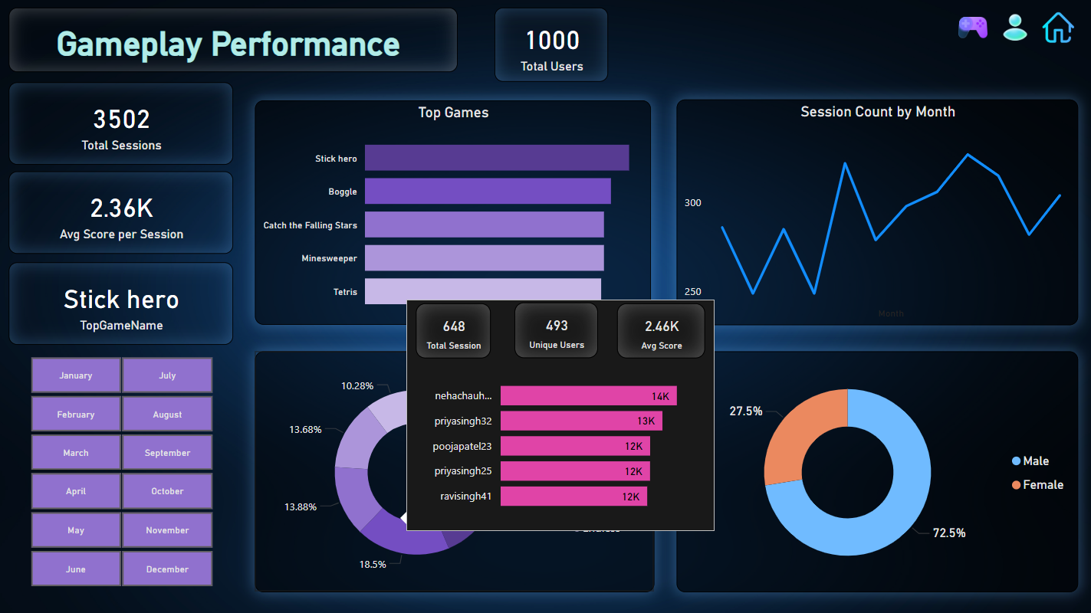
@funcore
Gameplay performance

Slide 19
@funcore
Key insights
Stick Hero, Boggle, and Catch the Falling Stars emerged as the most played games across all users.
The Classic game category received the highest overall engagement.
Male users made up the majority of the player base, accounting for approximately 72.5%.
A significant 70% of users fell within the 15–25 age group, indicating a primarily young audience.
Adult males (ages 25–40) showed a strong preference for playing Boggle.
Multiplayer games recorded the longest average session times, suggesting higher user retention during interactive gameplay.

Slide 20
@funcore
Challenges faced
Maintaining data consistency across relational tables.
Writing efficient SQL queries for large datasets.
Balancing dashboard clarity with complexity.

Slide 21
@funcore
Conclusion
Funcore’s analytics dashboard offers deep insight into player behavior.
SQL uncovered key patterns in game usage and user habits.
Power BI turned raw gameplay data into visually compelling business insights.
This project demonstrates expertise in SQL, dashboarding, and data storytelling.

Slide 22

THANK YOU
Endless Games, One Destination
@piyush_upadhyay

